Slide 1
Satellite Communication Link
Connecting the Earth through Space
Presented By Nazibur Rahman (IT - 21017)
Course Code: ICT - 4201
Course Name: Wireless and Mobile Communication
Course Teacher
Dr. Md. Nazrul Islam Associate Professor Dept. of ICT, MBSTU
October 31, 2025

Slide 2
Agenda
1
2
3
4
5
6
7
8
9
10
11
12
13
14
15
History
Signal Journey Interesting Facts Introduction Basic Concept Components Working Principle
Types of Satellites Frequency Bands Applications
Advantages and Limitations Future Trends
Conclusion References Q&A

Slide 3
History of Satellite Communication
The idea of satellites first came from Arthur C. Clarke in 1945.
In 1957, Sputnik 1 from the Soviet Union became the first artificial satellite.
The first communication satellite, Telstar, was launched in 1962 and made live TV between continents possible.
Today, thousands of satellites work for communication, weather, and science.

Slide 4
How Do Signals Travel?
Ground stations convert voices, video, or data into signals. The signals are sent to the satellite far above Earth.
Satellites process and send them to other places on Earth. Signals must be strong and clear for good communication.

Slide 5
Interesting Facts
There are over 7,000 active satellites in space now.
Many satellites travel at more than 25,000 kilometers per hour. Weather and GPS satellites help save lives.
Sometimes satellites collide because space is getting crowded.

Slide 6
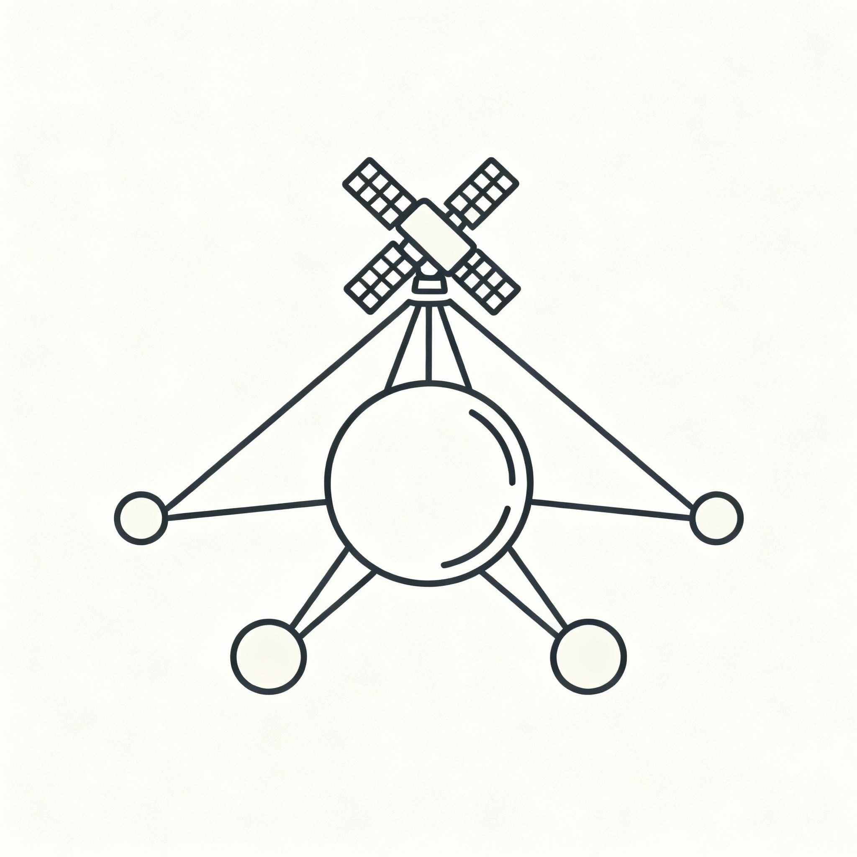
Introduction
Satellite communication helps us send signals all across the world.
It is used for TV, radio, internet, navigation and weather updates.
Satellites are useful even in places where ground networks cannot reach.
Figure 1: Satellite Communication Overview

Slide 7
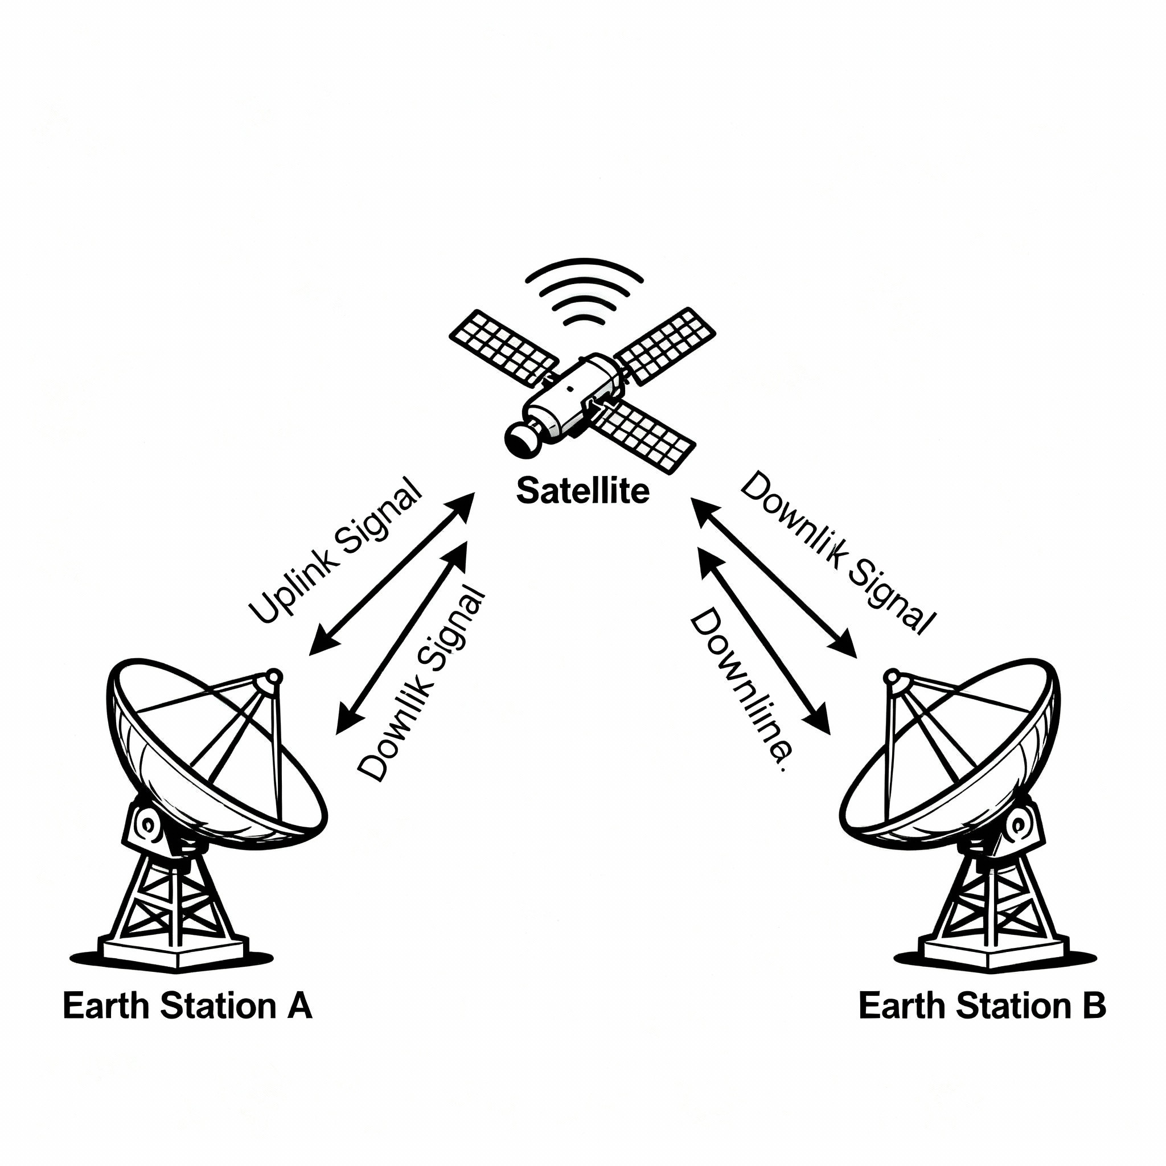
Basic Concept
Uplink means signal goes from a ground station up to the satellite.
The satellite catches the signal, makes it stronger and changes its frequency.
Downlink is when the signal comes down to a ground station.
In this way, the satellite works like a big repeater in space.
Figure 2: Uplink and Downlink Schematic

Slide 8
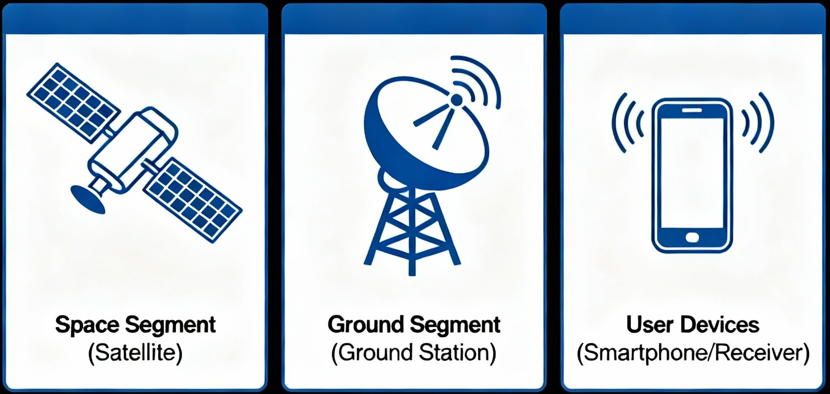
Main Components
The space segment is the satellite and its equipment.
The ground segment is the stations, antennas, and control centers.
The user segment means TVs, GPS devices, and satellite phones.
Figure 3: Communication System Components

Slide 9
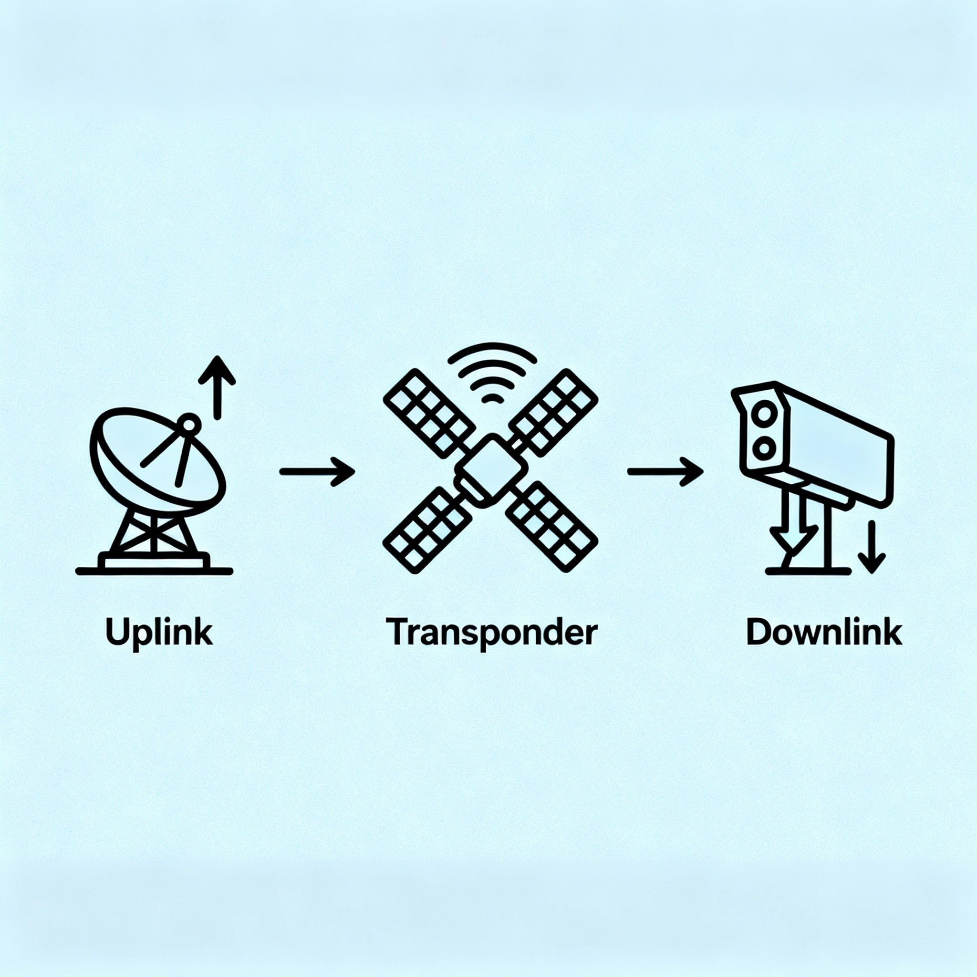
Working Principle
1
The ground station sends up a signal. This is called uplink.
The satellite receives and boosts the signal.
The boosted signal comes down to Earth as downlink.
This final signal goes to user devices like TV or phone.
2
3
4
Figure 4: Principle of Satellite Operation

Slide 10
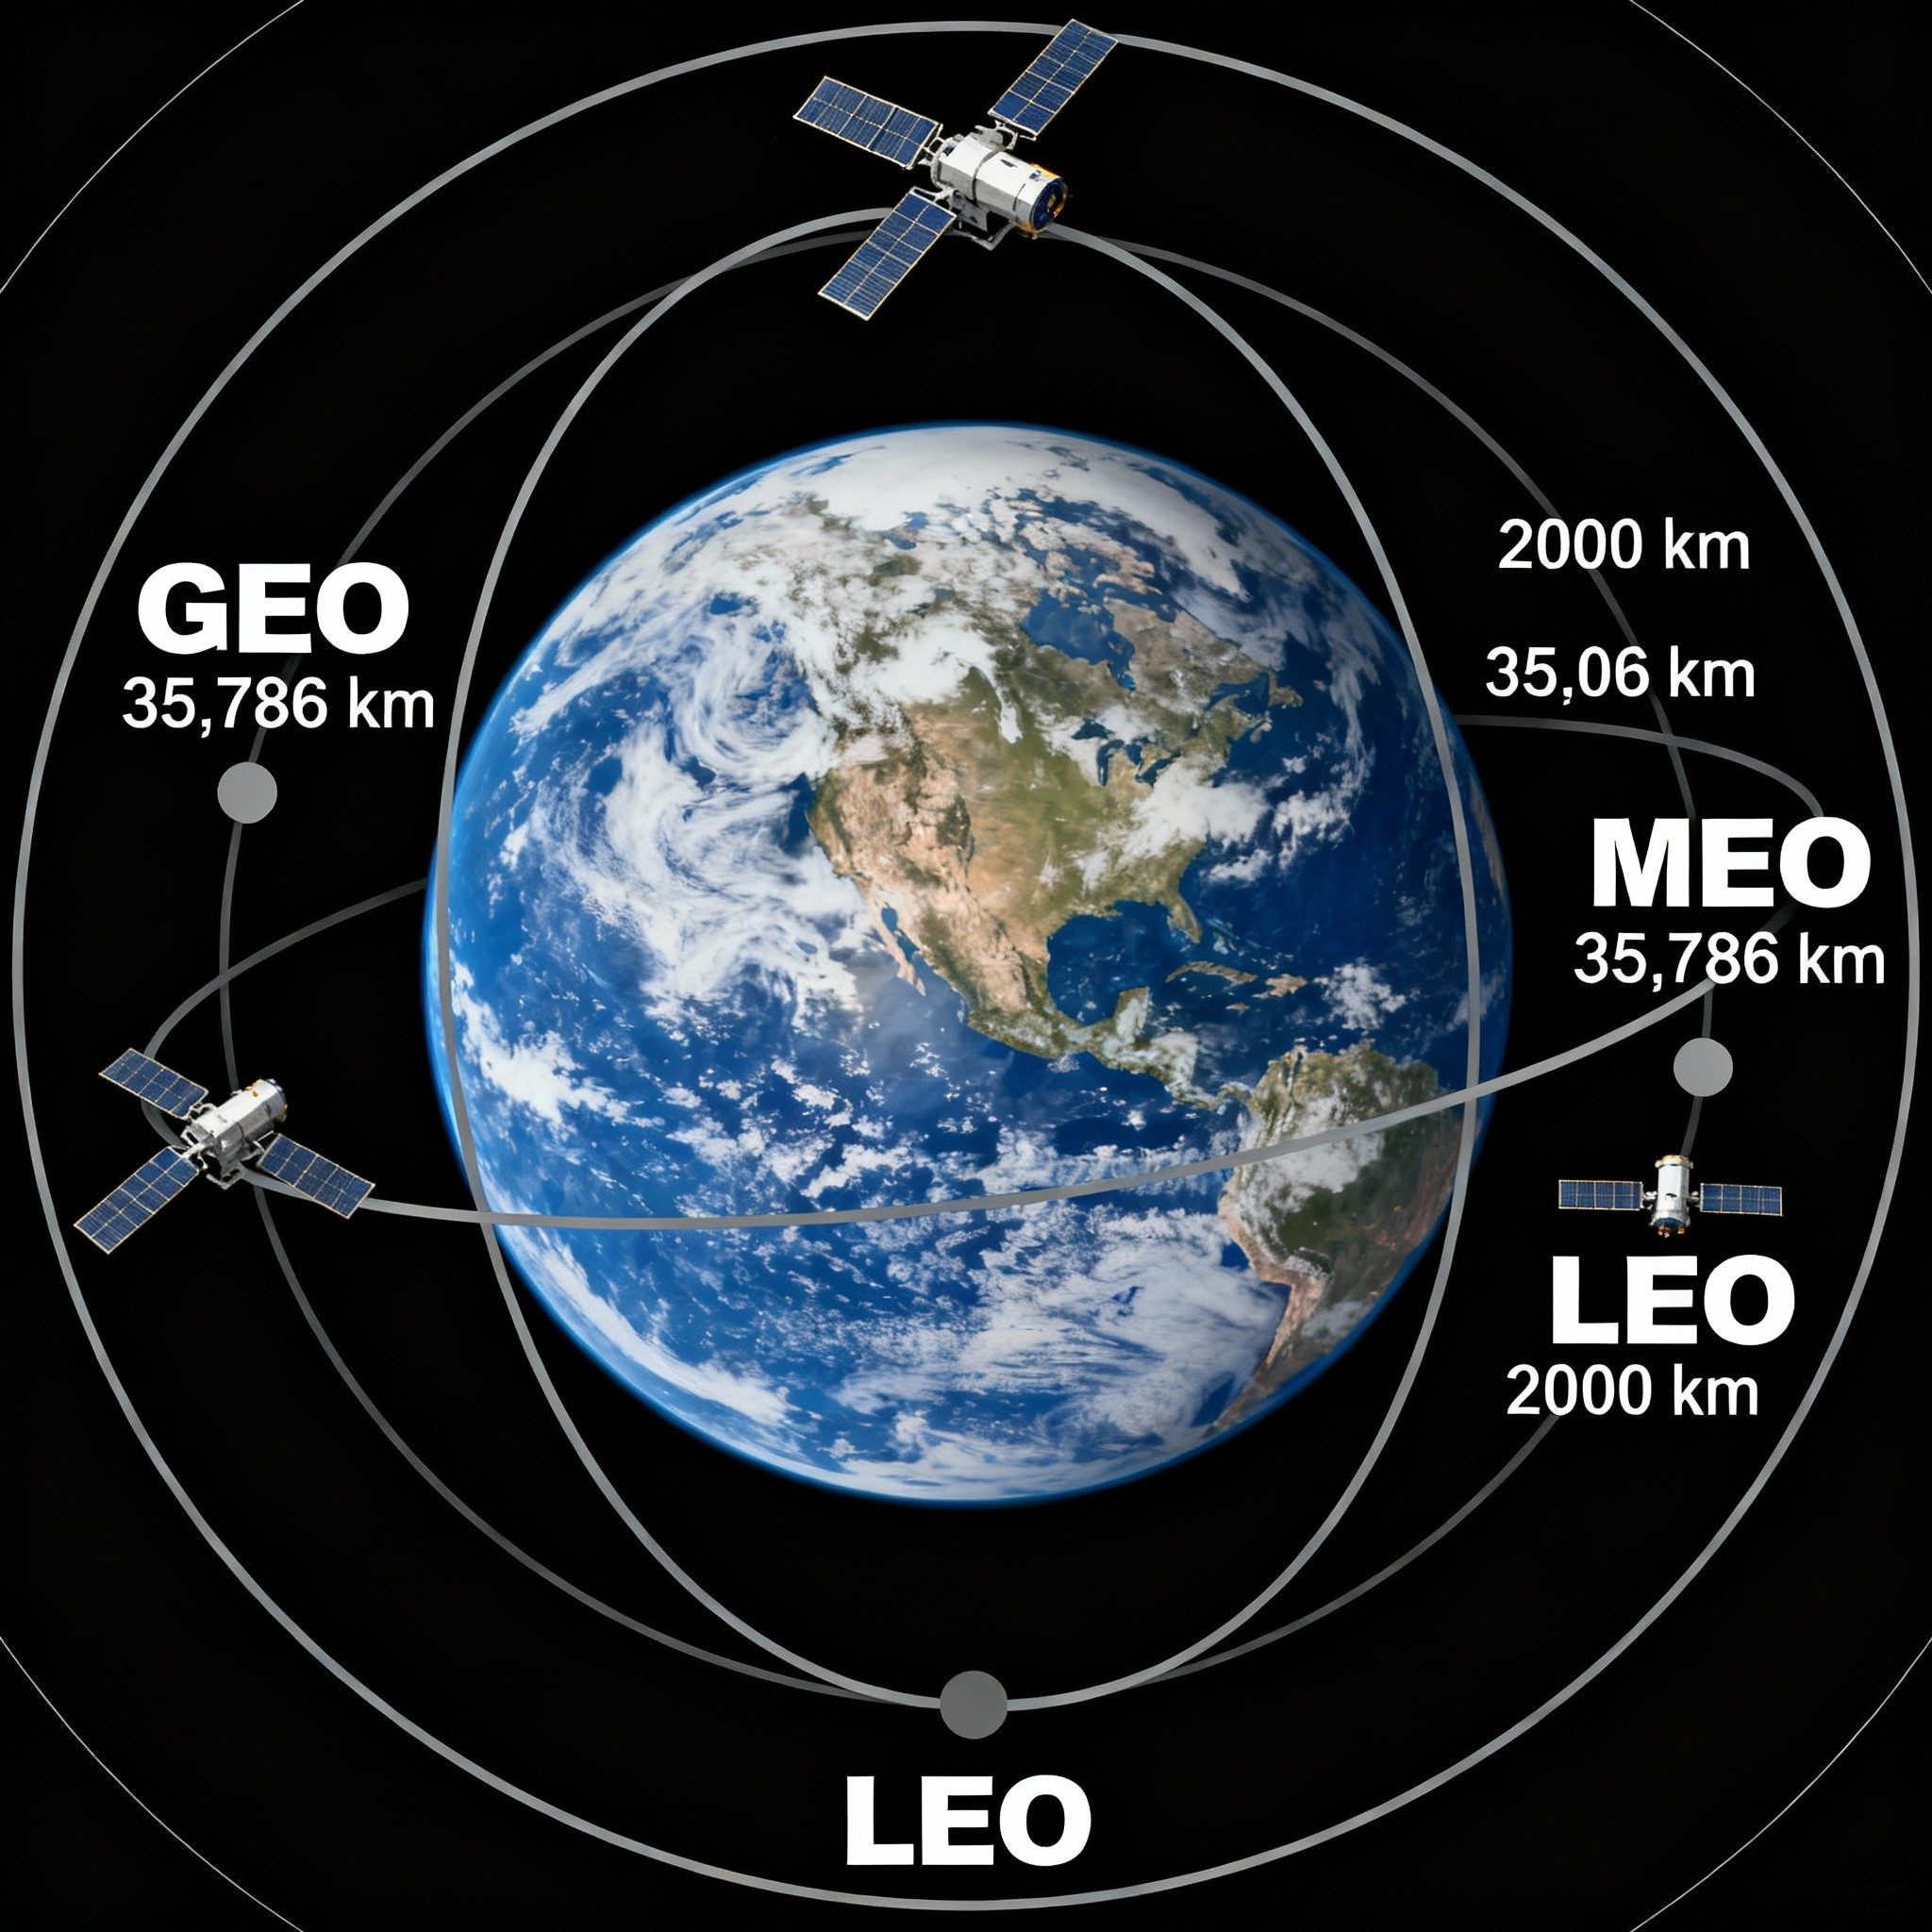
Types of Communication Satellites
GEO satellites stay fixed above one point and are used mostly for TV.
MEO satellites move around the Earth and are used for GPS.
LEO satellites are closer and move fast. They help with fast internet like Starlink.
Figure 5: Satellite Orbits

Slide 11
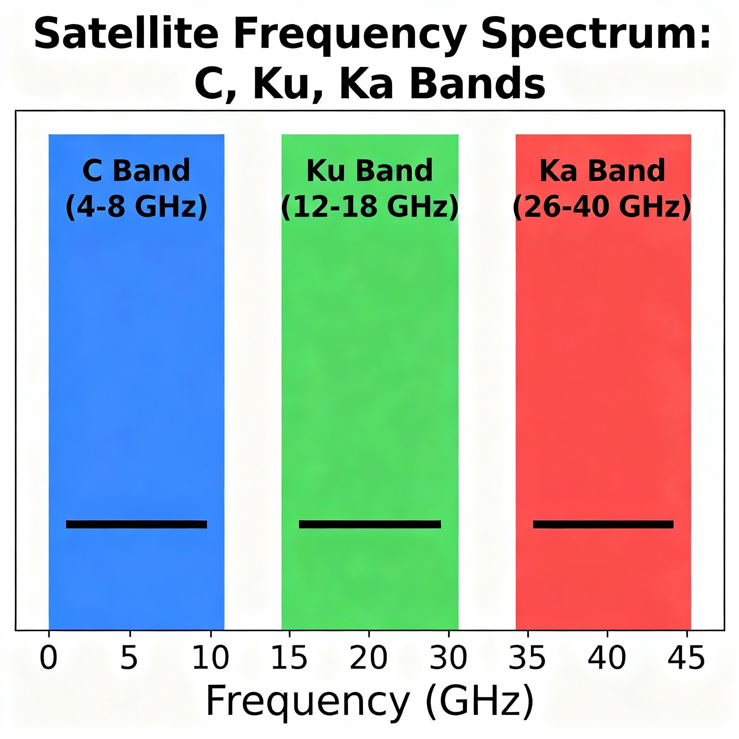
Common Frequency Bands
C-Band is used for TV and works even in bad weather.
Ku-Band is popular for satellite TV and the internet.
Ka-Band is used for very fast broadband.
L Band and S Band are used for GPS and satellite phones.
Figure 6: Satellite Frequency Bands

Slide 12
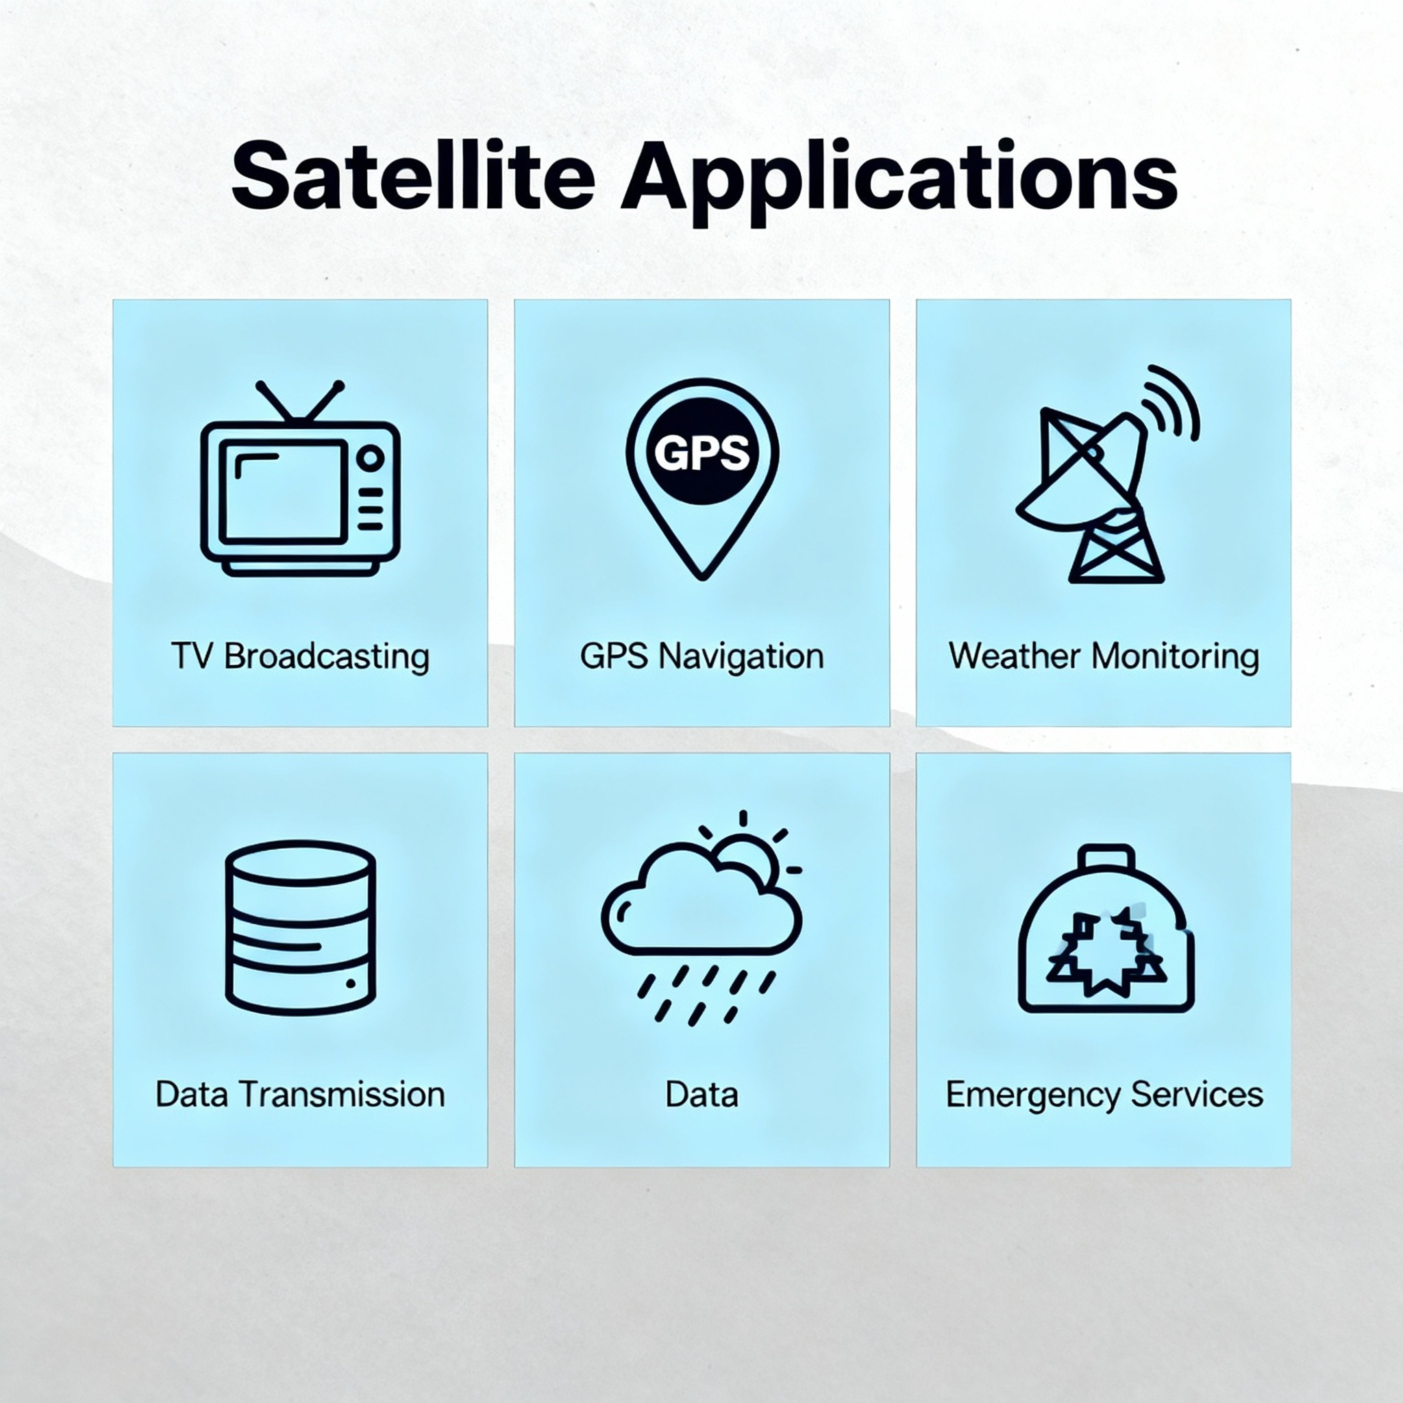
Applications
Satellite communication is needed for TV and radio.
It provides the internet in remote areas.
GPS helps with navigation and finding places.
Weather satellites help with forecasts.
Satellite links are used for disaster management.
Figure 7: Satellite Communication Applications

Slide 13
Advantages and Limitations
Advantages:
Satellites can reach every part of the world. They provide fast and reliable data.
They work where ground network is not available.
Limitations:
It is expensive to launch and maintain satellites. Signals from GEO satellites may be delayed.
Bad weather can cause problems with the signal.

Slide 14
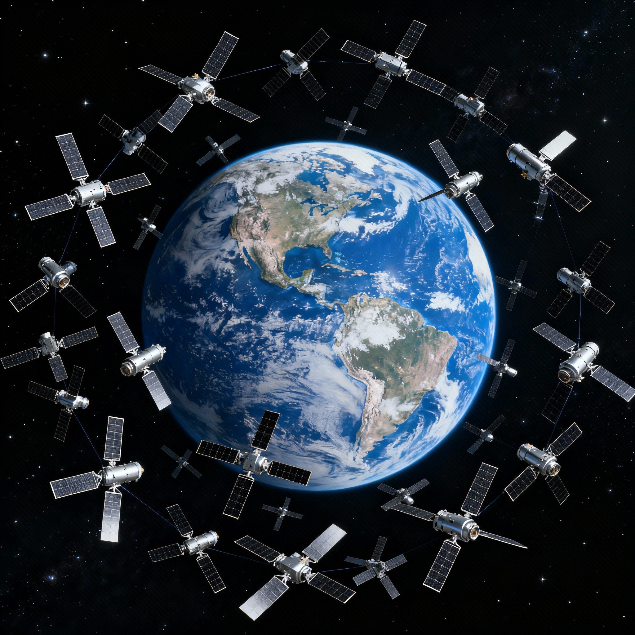
Future Trends
New LEO satellite networks like Starlink give internet worldwide.
Satellites are working with 5G and IoT for smart networking.
Quantum satellites are coming for super safe communication.
Rocket launches cost less because rockets are reused.
Figure 8: Starlink and Next Gen Satellites

Slide 15
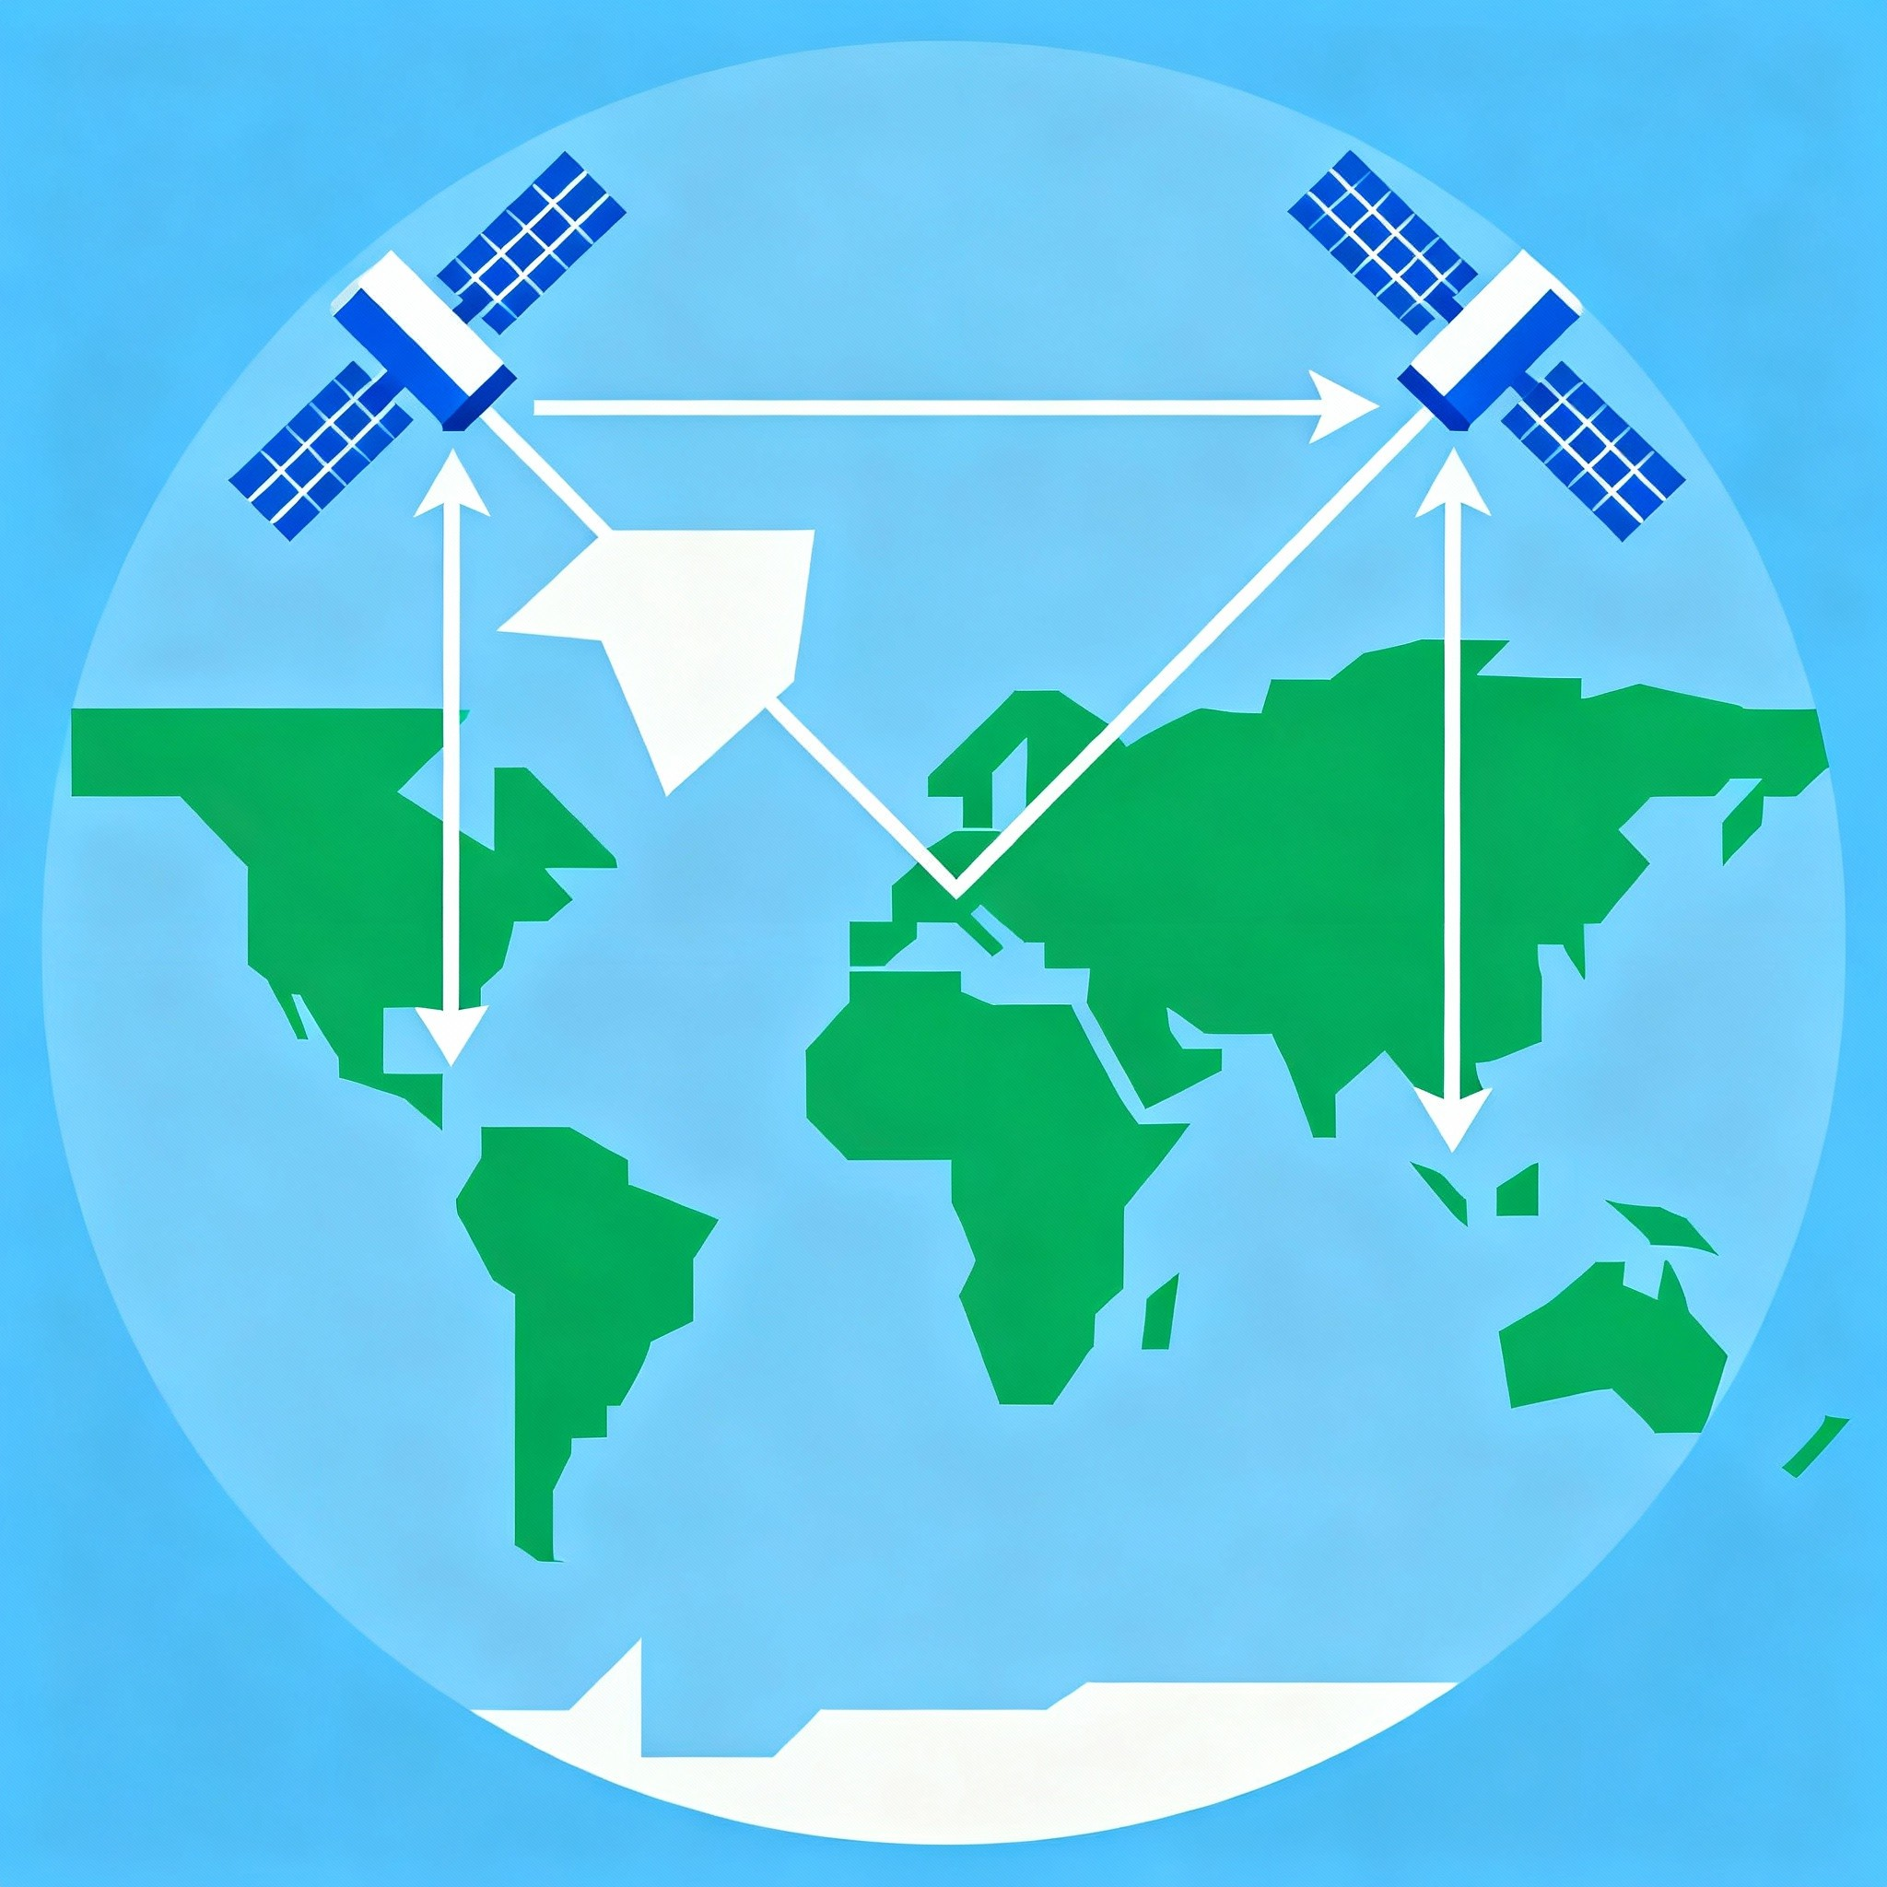
Conclusion
Satellites connect people, places and services all over the world.
They play a key role in TV, navigation, internet and safety.
Technology will keep improving for faster and easier communication.
Figure 9: Connectivity Across the World

Slide 16
References
Roddy, D. Satellite Communications.
Sklar, B. Digital Communications: Fundamentals and Applications.
NASA Official Website: https://www.nasa.gov
IEEE Spectrum Articles on Satellite Technology.

Slide 17
Thank You!
Q/A Session

